Slide 1
AIPLIRS Unedited presentation (POSMD)
Jufrey Niño E. Bayog
John Paul S. Bobila
Systems Development
PIMD-ICT

Slide 2
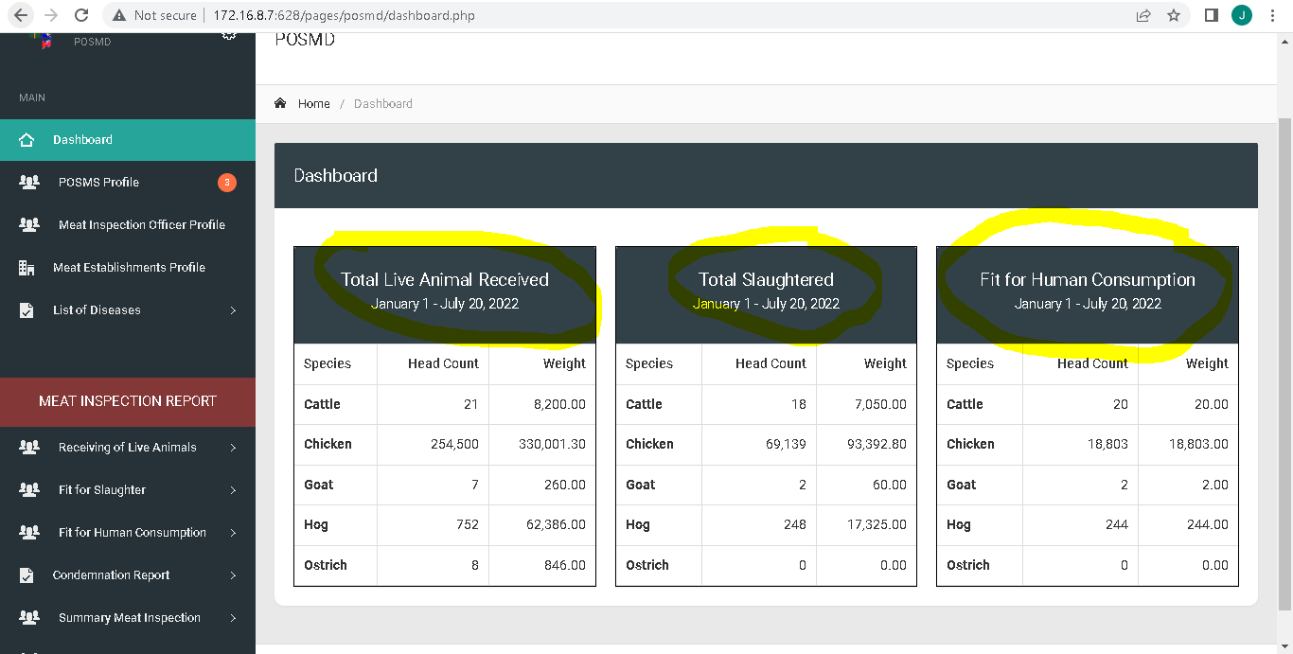
Change table header to
1st column : Total Number of Animals Received
2nd Column: Total Number of Animals Slaughtered
3rd Column: Total Volume of Meat Fit For Human Consumption
Remove Breadcrumbs in all pages.
Fit for Human consumption specify What kind of meat additional column after head count
Species | head count |Meat type | Weight : Column order

Slide 3
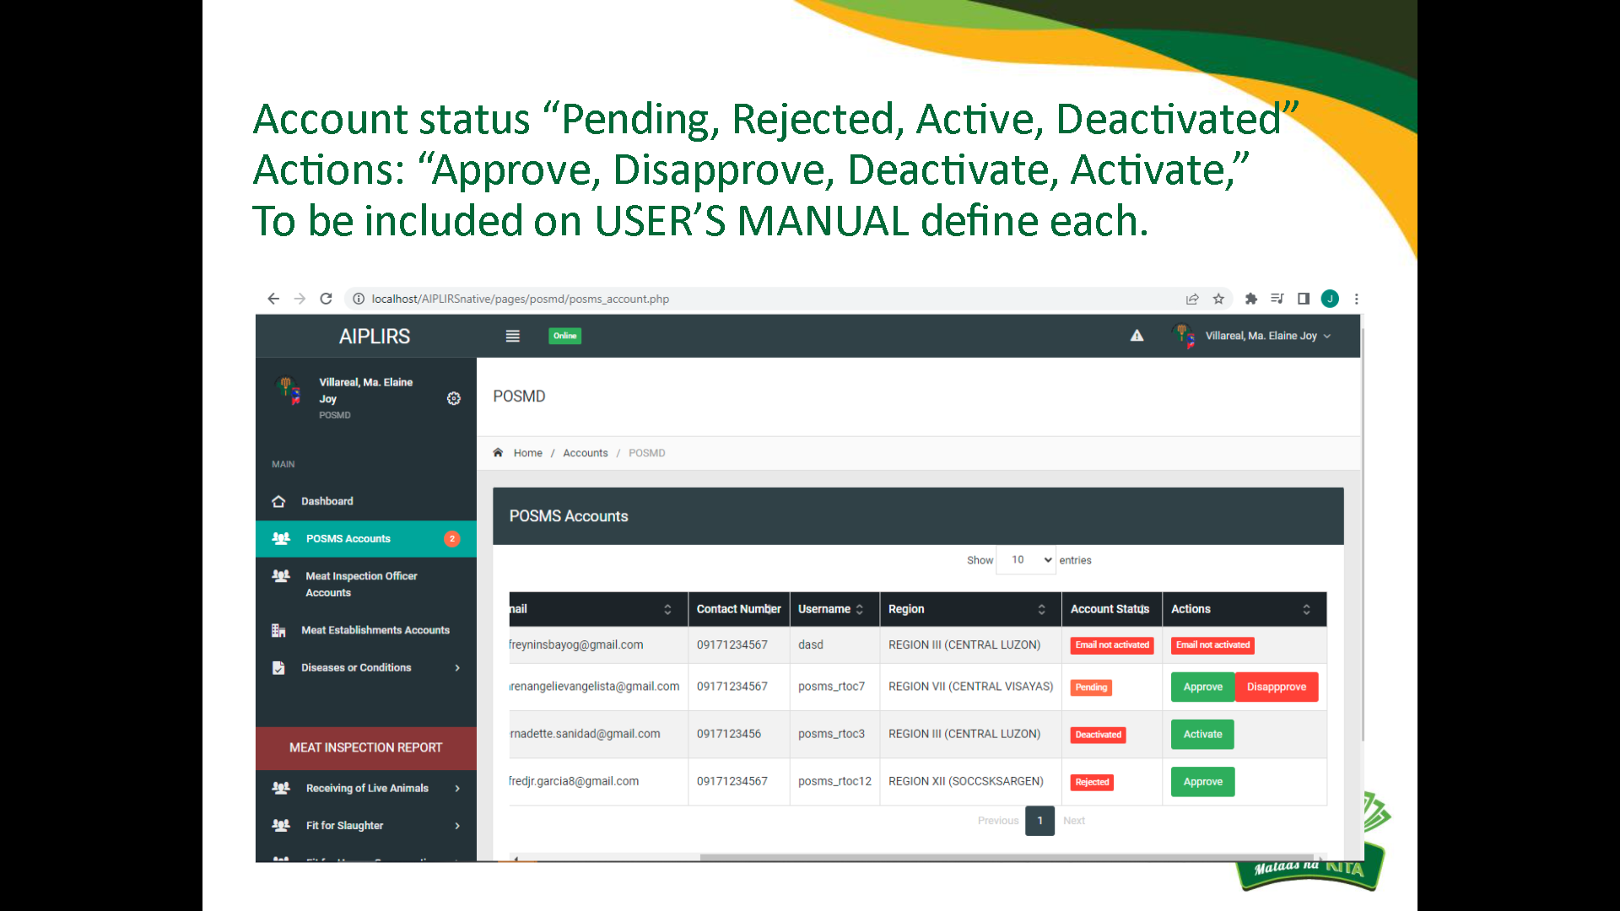
On popup reject to disapprove
On pop up remove header and remove d on “approved”
Account status “Pending, Rejected, Active, Deactivated”
Actions: “Approve, Disapprove, Deactivate, Activate,”
Om pop up Remove “d” on approved
Remove header modal leave modal body
Employee code to Employee Number
Account status: change “rejected” to “disapproved”
Same with MIO / POSMS accounts

Slide 4
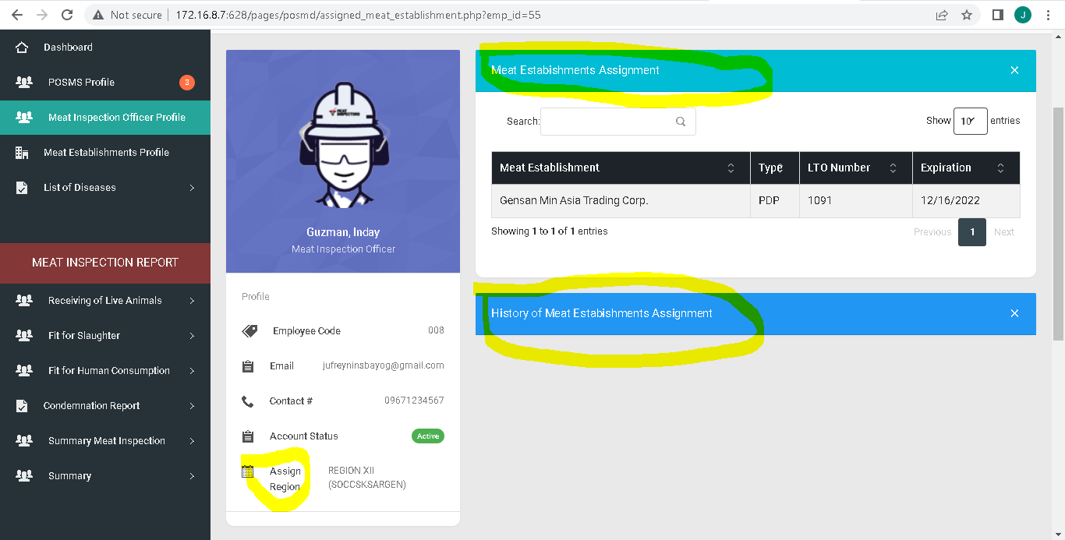
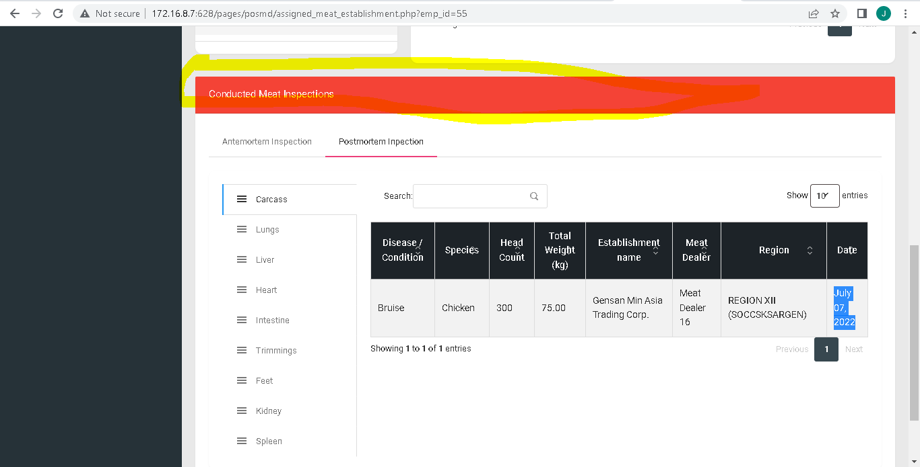
Make it landscape style
Current Meat Establishment Assigments
Change profile to accounts
Previous meat establishment assignments
Current Meat Establishment must not visible on previous Meat Establishment
Start and End date of service
“Code” to Employee number
Conducted Meat Inspections to Meat Inspection Activities
Establishment name to Meat Establishment

Slide 5
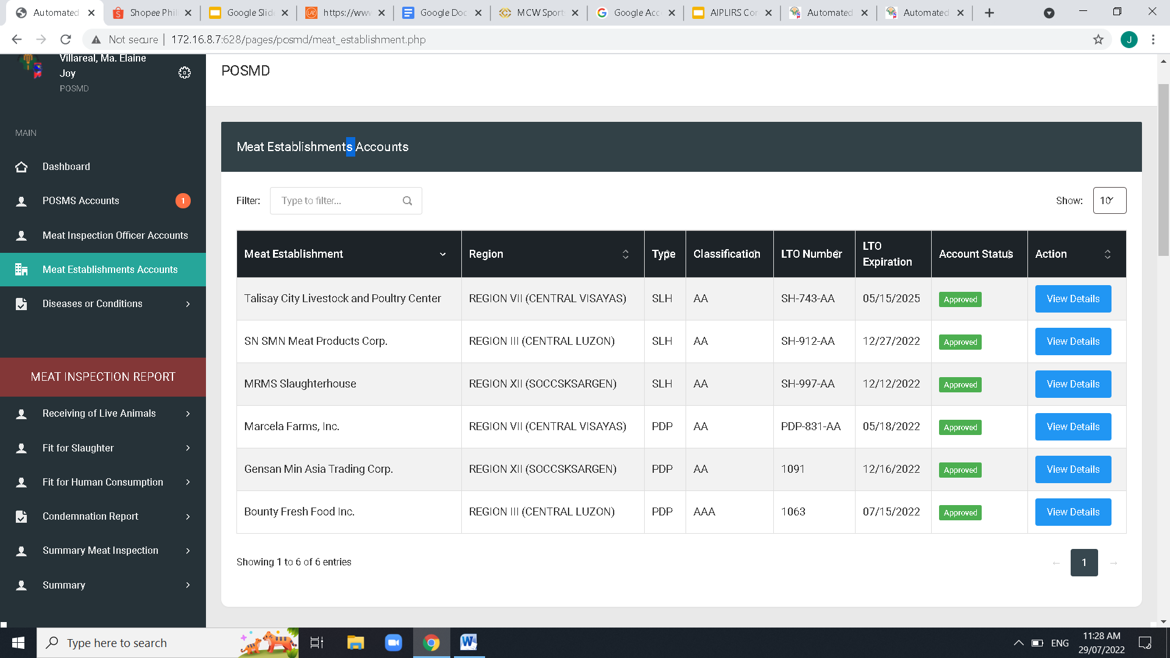
Add a column for region
Remove “s” Meat establishments
Remove “s” Meat establishments

Slide 6
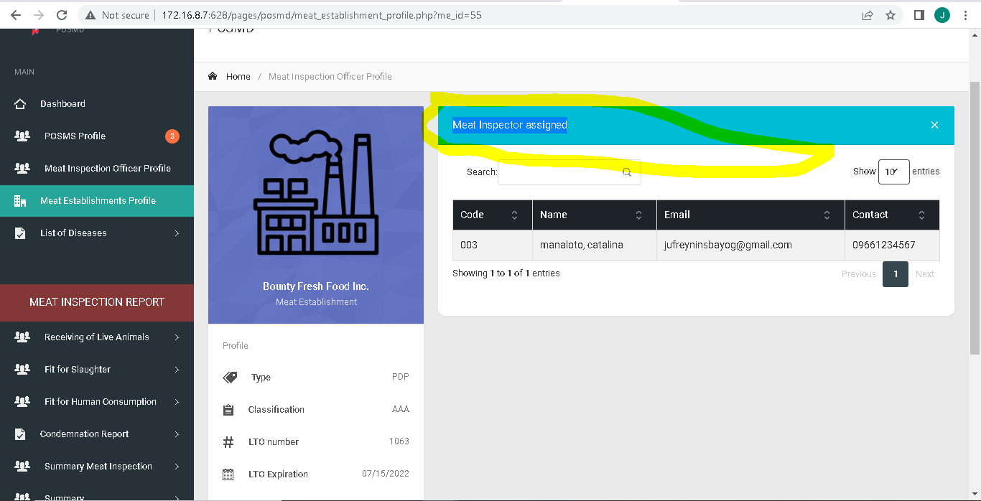
Change to Current Meat Inspection Officer
Make landscape style
Remove “x”
Assigned Meat Inspection Officer
“Code” to Employee number
Add a card Previous Meat Inspection Officer
Change address format to “street, barangay, city, province and the design make landscape

Slide 7
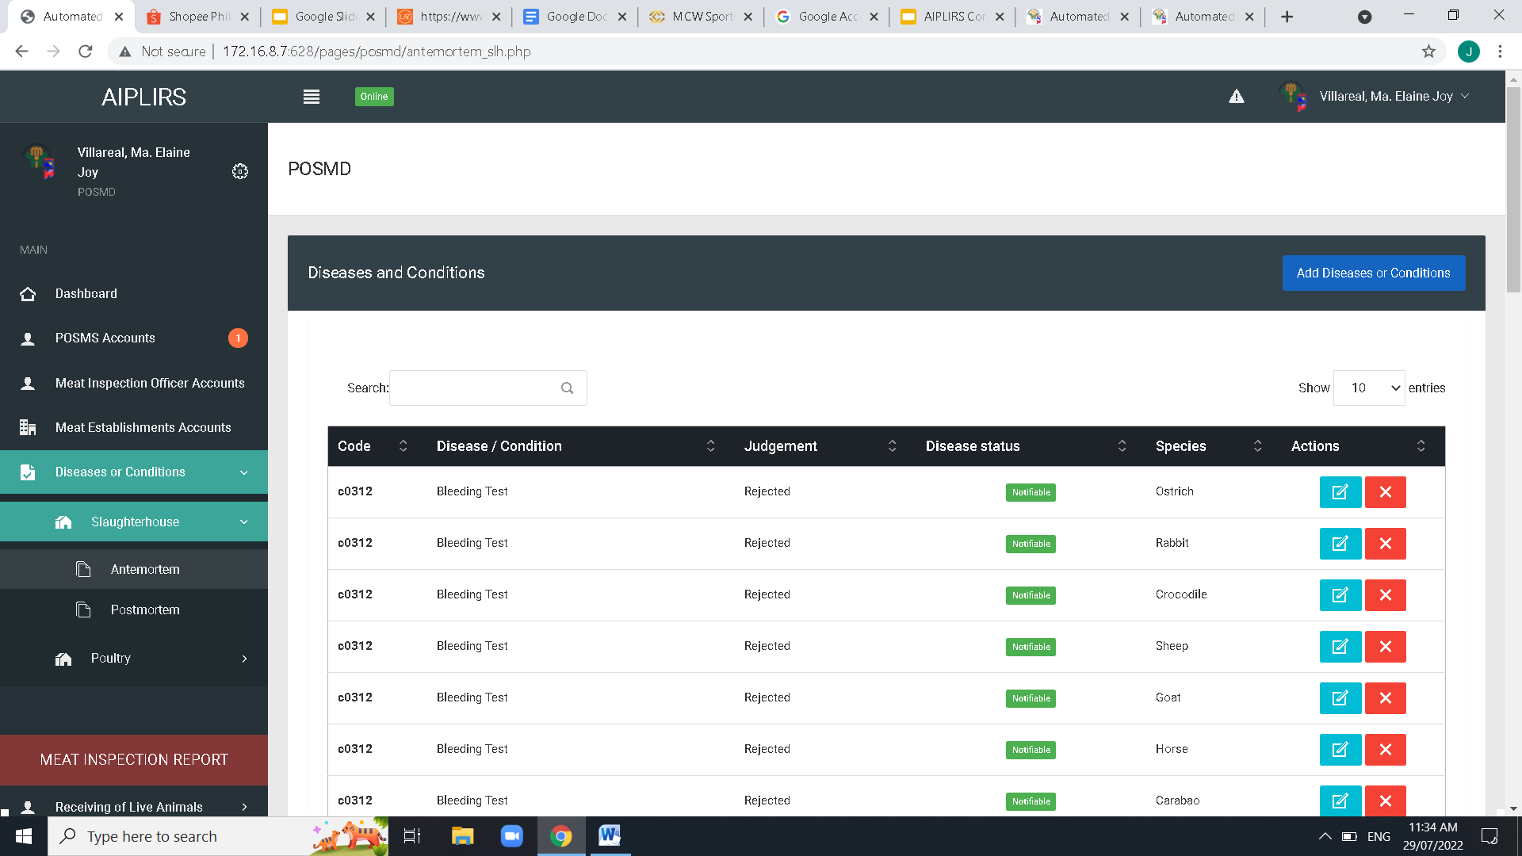
Diseases and Conditions during Ante-mortem Inspection in Slaughterhouse ( same for Poultry Dressing Plant)
Change to Add disease or condition
Create a checkbox filter
Diseases and Conditions
Change Poultry to Poultry Dressing Plant
Table Column order: Code - Disease / Condition – Judgement – Species- Disease Status-ACTIONS and Spacing of Table data

Slide 8
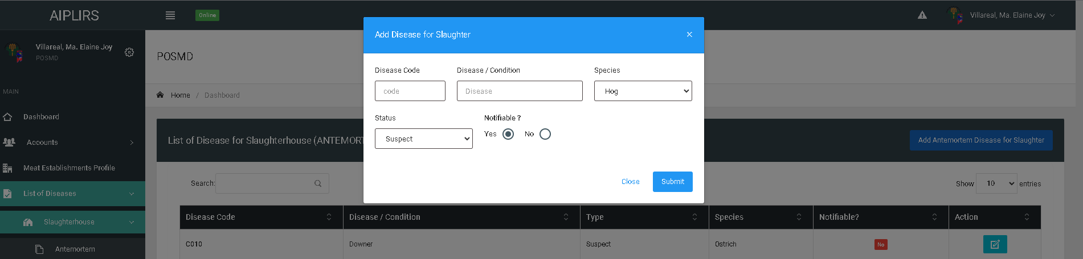
Code
Suggestion: Use tick-boxes when selecting for multiple species

Slide 9
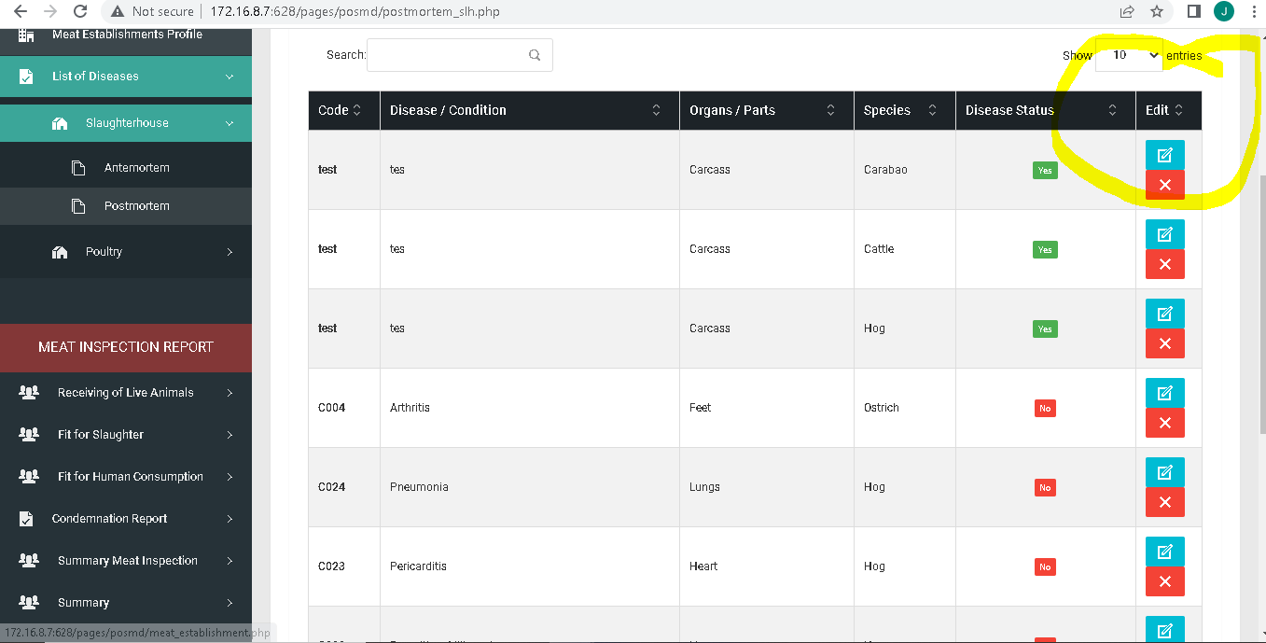
Add a column for judgement
Table Column order: Code - Disease / Condition – Judgement – Organs/Parts – Species- Disease Status-ACTIONS and Spacing of Table data

Slide 10
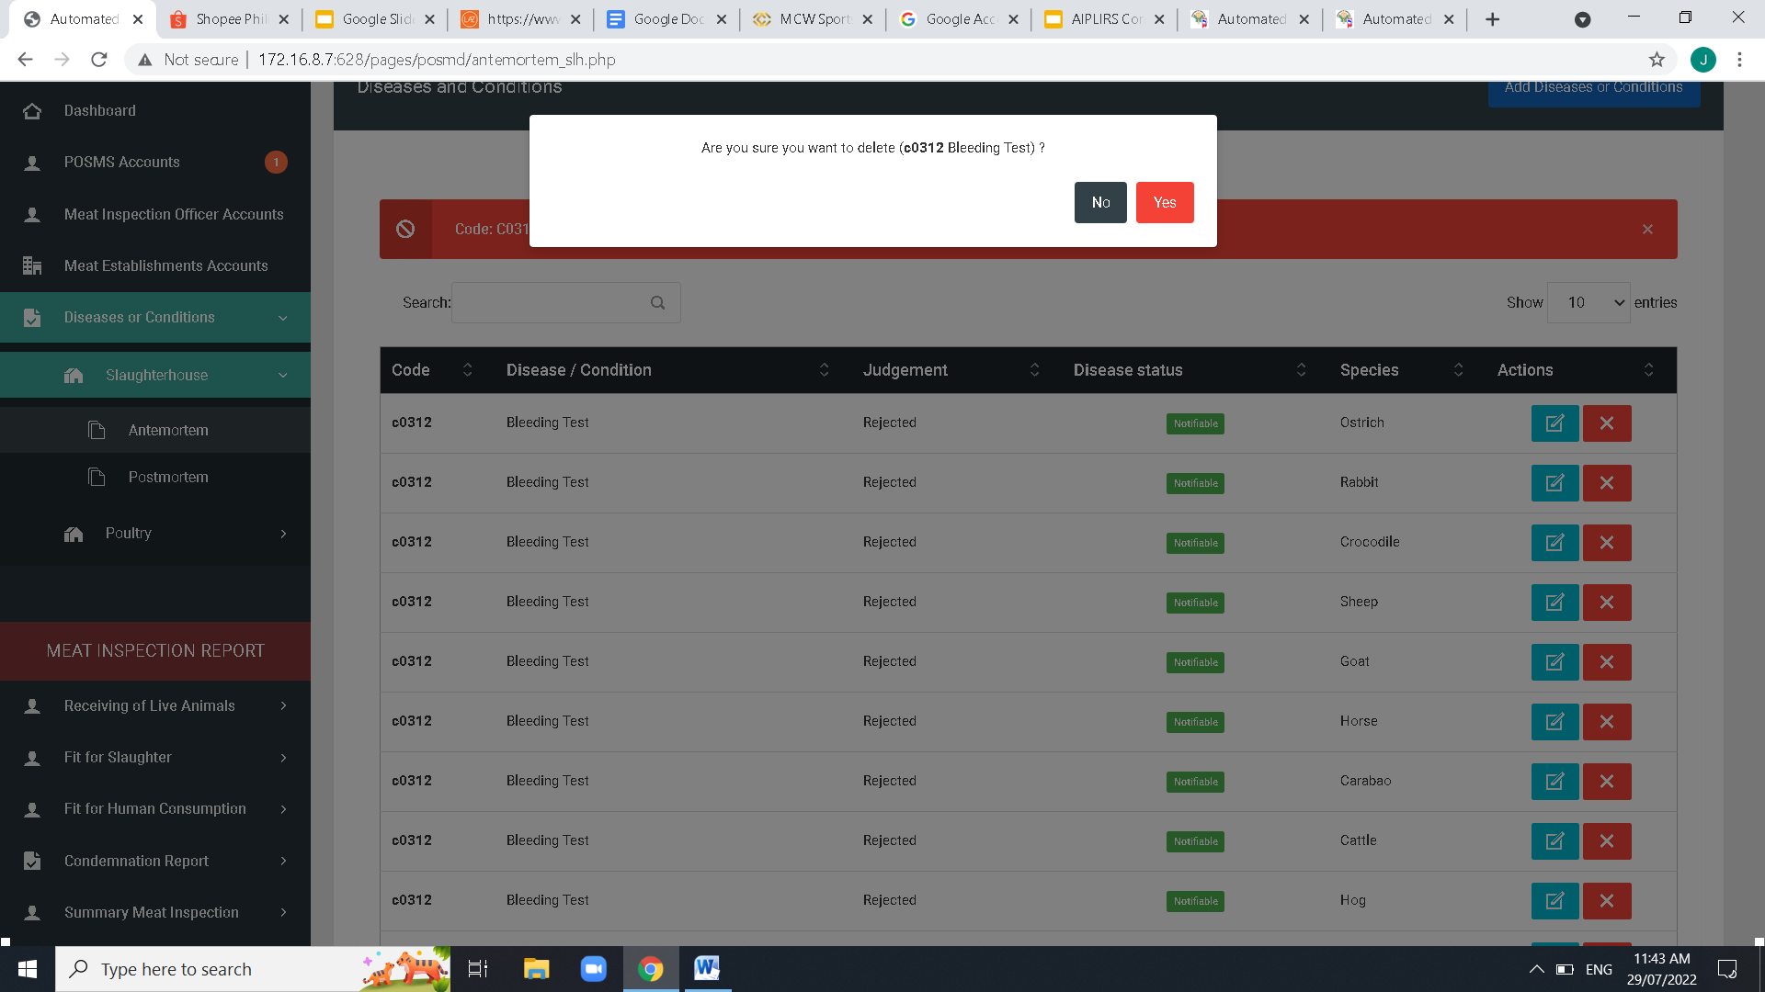
Center button modal
Change button color to Red- No / Green-Yes
TO ALL POP UP QUESTION
Change Font size into a readable size

Slide 11
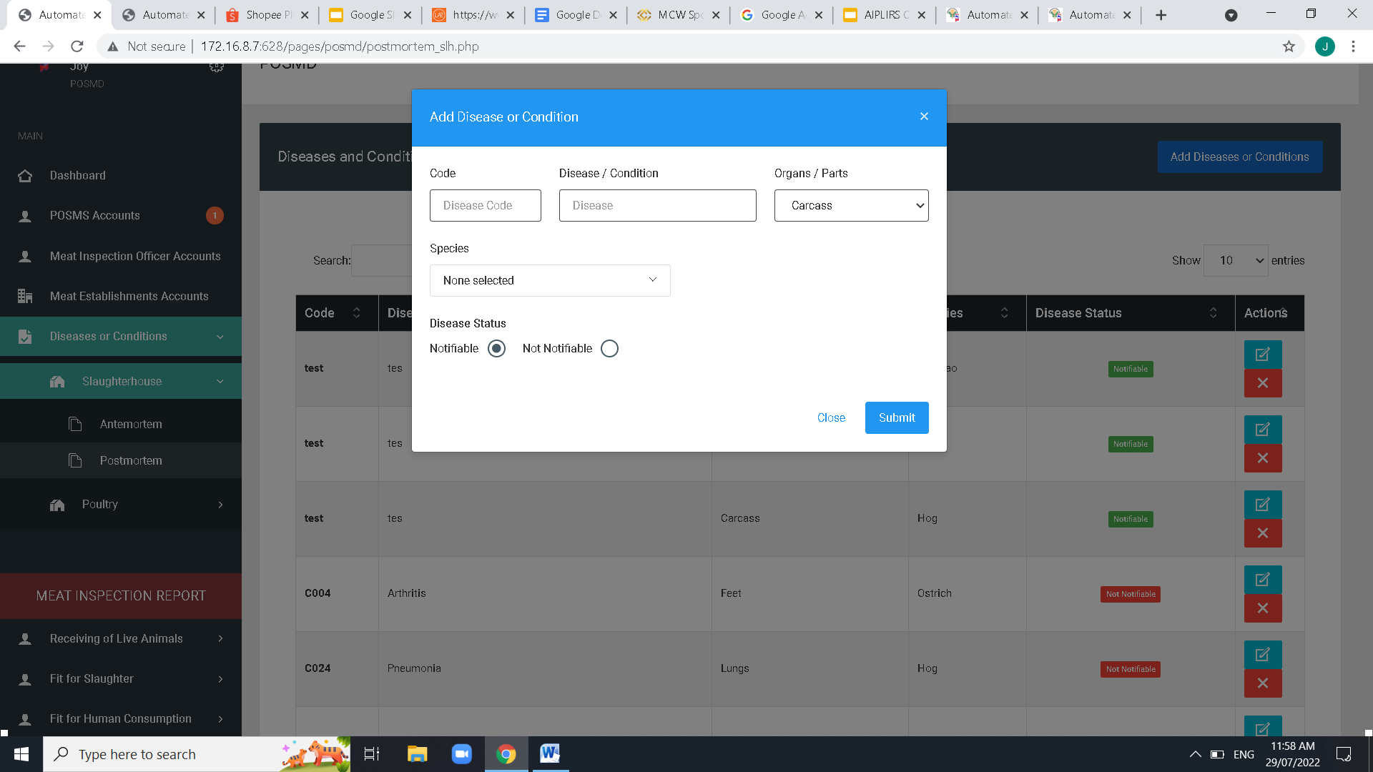
before species dropdown add judgement dropdown

